Slide 1
Churn Prediction in Telecom Domain
Mentors:
GAUTHAM
&
Ashish Poigal
Presented by:
M.V.S. VIDHYA SAGAR
Batch - 20

Slide 2
Contents
Objective
Introduction
Business Problem
Data Exploration
Data Pre-Processing
Feature Extraction
Applying Different Classification Models
Comparison & Results
Other Techniques
References

Slide 3
Objective
The objective of the context is to predict customer churn. We have a dataset that has customer usage pattern and we have to identify whether the customer has churned or not.

Slide 4

Introduction
The Percentage of subscribers moving from a specific service or a service provider to another in a given period of time know as churn rate.
Types of Churns
Involuntary: Involuntary are easy to determine i.e.;
the telecom industry itself decides to
remove the customer as their subscriber.
Voluntary : voluntary churn are difficult to determine.

Slide 5
Why do customers churn?
Due to lack of customer satisfaction like
1. Telecom service options i.e.; voice(pre-paid, post-paid),
(DSL,3G,4G), voice data.
2. Plan Costs
3. Demography

Slide 6
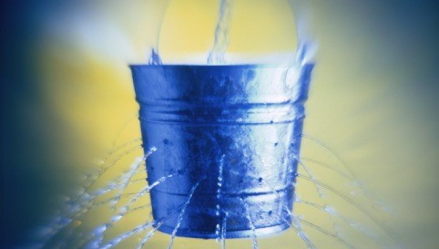
Business Problem
Telecommunication market is expanding day by day. Companies are facing a severe loss of revenue due to increasing competition hence the loss of customers. They are trying to find the reasons of losing customers by measuring customer loyalty to regain the lost customers. The customers leaving the current company and moving to another telecom company are called churn.

Slide 7
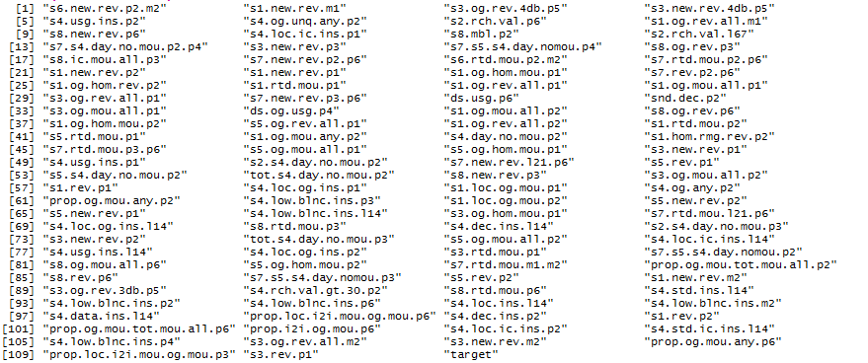
Data Exploration
We have 111 columns including target attribute and 25000 rows.

Slide 8
We are having only very minimal information about the variables i.e.,
Rev: Revenue
ic : Incoming calls
Og : Outgoing calls
Rmg: Roaming
Usg :Usage
Mbl : Mobile
Rch: Recharge
Mou: Minutes of usage
Loc : Location

Slide 9
Data Pre-Processing
Data Cleaning
->There are No Missing Values
-> There are No “NA”, “NULL” , “?” Values.
Type Conversions
-> There are no Categorical attributes except the “target” attribute, so only target
attribute is converted to factor.
Data Standardizing is done.
Outliers were removed by using cook’s distance
Class Imbalance is done.

Slide 10
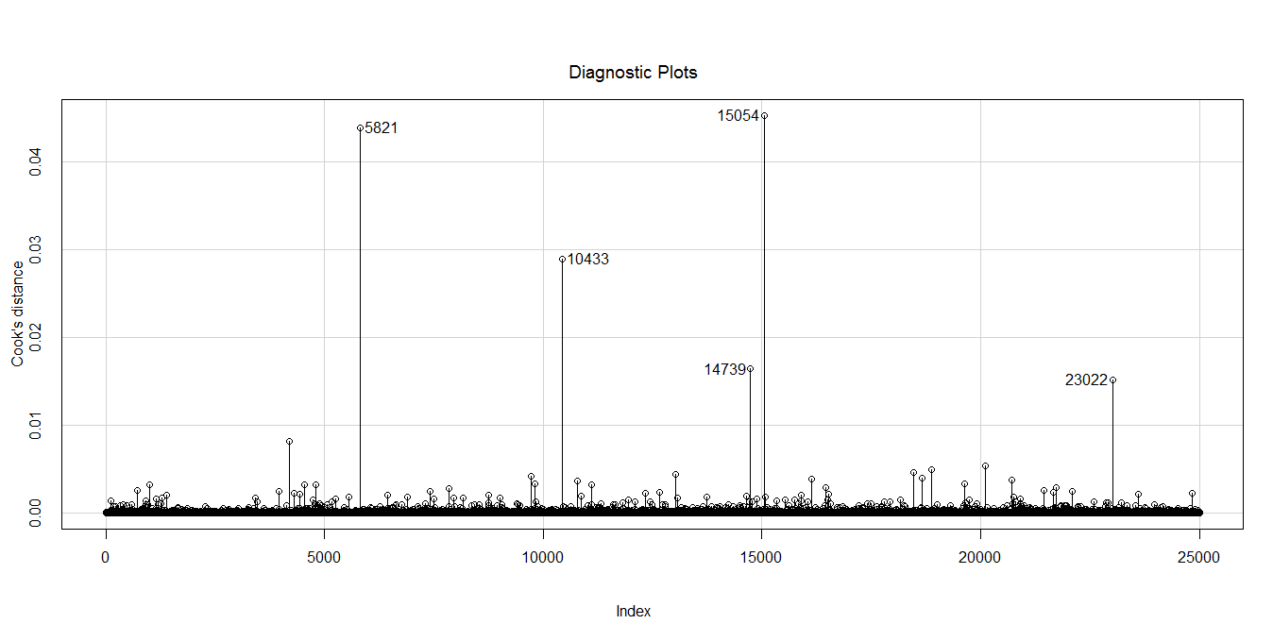
OUTLIERS

Slide 11
Feature Extraction
By Intuition and Domain understanding.
Important Features are selected using Random Forest.
21 attributes are selected as important attributes among 111 from the data set.

Slide 12
Important Attributes
ds.usg.p6
s7.new.rev.p3.p6
ds.og.usg.p4
s4.og.unq.any.p2
s2.rch.val.p6
s4.loc.ic.ins.p1
s3.og.mou.all.p1
s6.rtd.mou.p2.m2
s8.new.rev.p6
s6.new.rev.p2.m2
s1.rtd.mou.p2
s1.rtd.mou.p1
s8.ic.mou.all.p3
s1.og.rev.all.p2
s7.new.rev.p2.p6
s4.usg.ins.p2
snd.dec.p2
s3.og.rev.4db.p5
s3.new.rev.4db.p5
s3.new.rev.p3
target
Final Attributes after feature selection
Each independent attribute is selected based on its Information Gain. .

Slide 13

Applying Different Machine learning Techniques
Supervised Data
->Classification problem
Decision Trees(C5.0),Support Vector ,Machine, Logistic Regression,
Random Forest

Slide 14
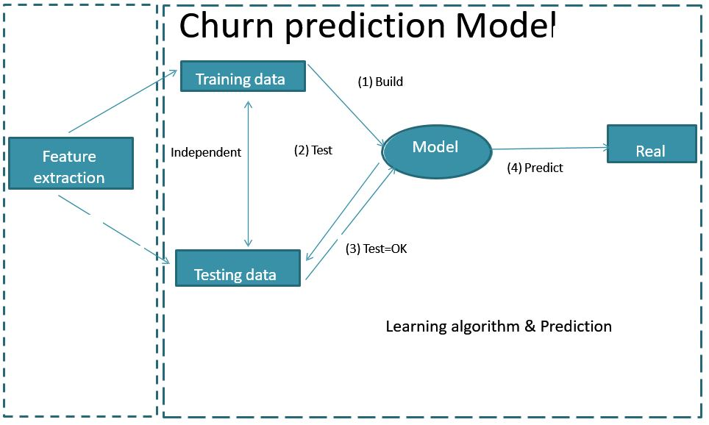
Build the model on the training dataset and test the accuracy’s on the test dataset.
Tune the model on the train dataset and again check error metrics on the test dataset until we get optimal tuning parameter.

Slide 15
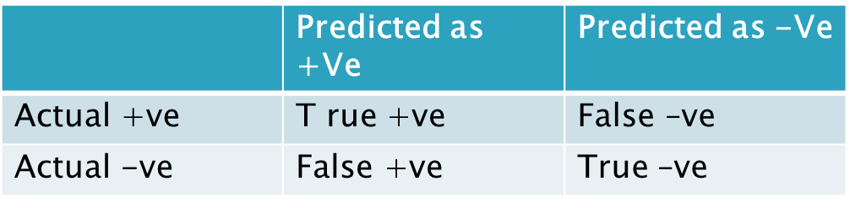
In same way build multiple models and select the best model which gives good Accuracy and reduces the misclassification error.
Important Error Metrics to be considered in churn prediction in telecom domain are
1.Accuracy
2.Recall
The customer who are going to churn required category(+ve) and who are not going to churn required(-ve) category.
Recall =T+ve/( T+ve + False –ve)
Accuracy=(T+ve + T-ve )/(Total sum)

Slide 16
RESULTS
I have applied 4 different classification algorithms to choose the best model which is giving good recall and accuracy.
 | Random Forests | Logistic Regression | Decision Trees | SVM (linear) | SVM (radial)
Accuracy | 83.83 | 73.5 | 80.98 | 73.50 | 81.06
Recall | 82.31 | 70.4 | 78.83 | 68.72 | 75.65

Slide 17
ANALYSIS
By analyzing the results it is clear that only Random Forests gives good recall and accuracy among all other classifiers. so as per our business scenario recall is more important that precision i.e., Customers who are churning should not be predicted as non-churners .
So I finally conclude that Random Forest is appropriate for this churn prediction in the telecom domain.
Calculation of error metrics for Random Forests:
Actual/Predicted | Not Churn | Churn
Not Churn | 3233 | 557
Churn | 658 | 3051
Recall : 3051/(3051+658) = 82.31
Accuracy : (3233+3051)/(3233+3051+658+557) = 83.83

Slide 18
Other Techniques
Further improvements can be done to this project by clustering the customer data and building multiple models on it and choosing the appropriate model for each cluster.

Slide 19
References
Applying Data Mining Techniques in Telecom Churn Prediction‖ , International Journal of Advanced Research in Computer Science and Software Engineering, N.Kamalraj Dr.A.Malathi , Department of Computer Technology PG and Research Department of Computer Science, Dr. SNS Rajalakshmi College of Arts and Science Govt. Arts College.
Anshul Goyal and Rajni Mehta, Assistant Professor,CSE. ―Performance Comparison of Naïve Bayes and J48 Classification Algorithms.‖
R Data: http://cran.r-project.org/
Vladislav Lazarov, Technische Universität München and Marius Capota, Technische Universität München, ―Churn Prediction‖,
Prof S. Chandrasekhar, ―Predicting The Churn In Telecom Industry‖‘.
Marcin Owczarczuk, ―Churn models for prepaid customers in the cellular telecommunication industry using large data marts‖, Expert Systems with Applications, 37 (2010) 4710–4712.

Slide 20


